Slide 1
Understanding Constructors and Destructors in PHP

Slide 2
Learning Objectives
- Understand what a constructor is and why it is used
01
- Write PHP classes using __construct() to initialize data
02
- Understand the purpose of __destruct() and how it works
03
- Demonstrate how constructors and destructors run automatically
04

Slide 3
What is a Constructor?
- A constructor is a special method that runs automatically when an object is created
- It is used to set initial values for the object’s properties

Slide 4
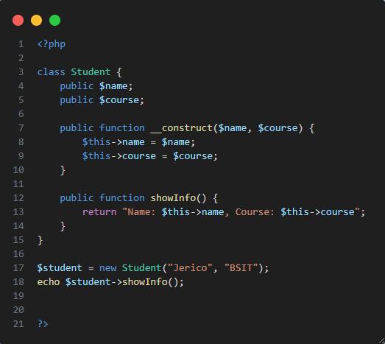
Example – Constructor in PHP

Slide 5
What is a Destructor?
- A destructor is a special method that runs automatically when the object is destroyed
- Useful for cleanup tasks like:
• Closing a file • Closing a database • Goodbye message

Slide 6
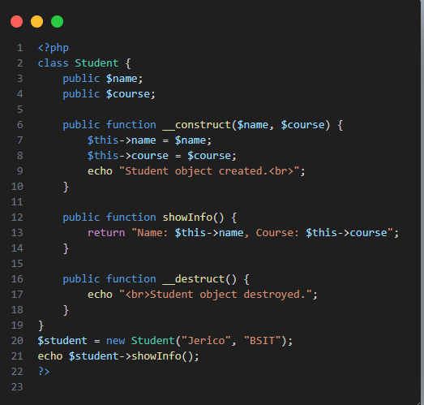
Example – Destructor in PHP

Slide 7
What is a Method Overloading?
Creating multiple methods with the same name but different numbers or types of parameters

Slide 8
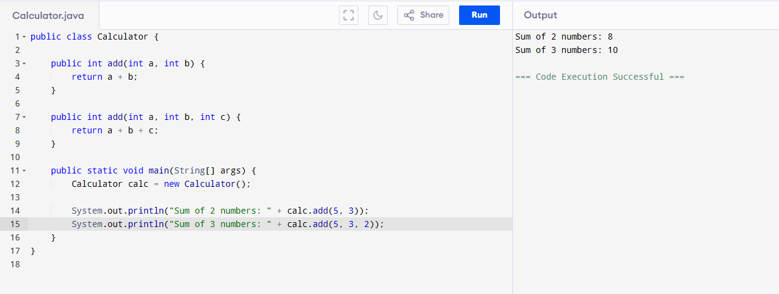
Java Example: Method Overloading

Slide 9
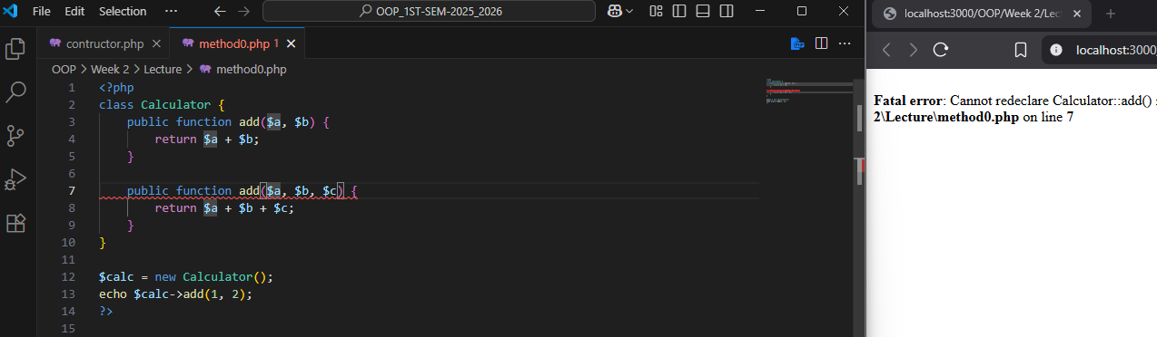
PHP Doesn't Support It Directly
PHP does not allow more than one method with the same name in a class
If you try, it will give a fatal error

Slide 10
How PHP Handles It Instead:
PHP uses a special magic method called __call() to simulate method overloading.
This method:
-Automatically runs when you call a method that doesn't exist
Receives:
The method name as a string
The arguments in an array
You can then check how many arguments were passed and handle each case differently

Slide 11
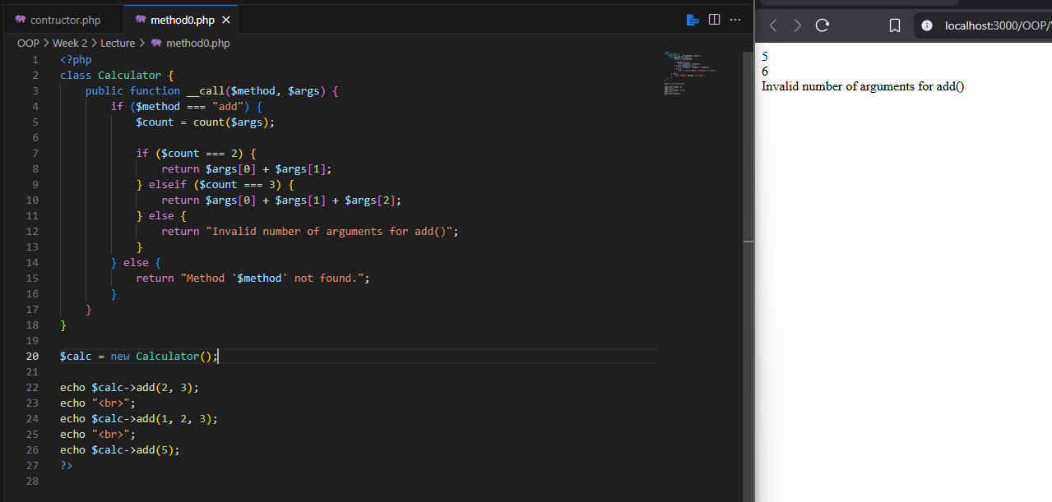
Method Overloading in PHP
Notes:
<?php
class Message {
public function __call($method, $args) {
if ($method === "greet") {
if (count($args) === 1) {
return "Hello, " . $args[0];
} elseif (count($args) === 2) {
return "Hello, " . $args[0] . "! You are from " . $args[1];
} else {
return "Invalid number of arguments.";
}
} else {
return "Method '$method' not found.";
}
}
}
$msg = new Message();
echo $msg->greet("Jerico");
echo "<br>";
echo $msg->greet("Jerico", "Pangasinan");
echo "<br>";
echo $msg->greet();
?>
<?php
class Messenger {
public function __call($method, $args) {
if ($method === "greet") {
if (count($args) === 1) {
return "Hello, " . $args[0];
} elseif (count($args) === 2) {
return "Hello, " . $args[0] . "! You are from " . $args[1];
} else {
return "Invalid arguments for greet().";
}
} elseif ($method === "farewell") {
if (count($args) === 1) {
return "Goodbye, " . $args[0];
} elseif (count($args) === 2) {
return "Goodbye, " . $args[0] . "! See you in " . $args[1];
} else {
return "Invalid arguments for farewell().";
}
} else {
return "Unknown method '$method'.";
}
}
}
$msg = new Messenger();
echo $msg->greet("Jerico");
echo "<br>";
echo $msg->greet("Jerico", "Pangasinan");
echo "<br>";
echo $msg->farewell("Jerico");
echo "<br>";
echo $msg->farewell("Jerico", "Manila");

Slide 12
SUMMARY
Constructor is a special method that automatically sets initial values when an object is created.
Destructor is a special method that runs when the object is destroyed to clean up or finalize tasks.
Method overloading in PHP is simulated using __call() to handle method calls with different numbers of arguments.
Notes:
<?php
class Message {
public function __call($method, $args) {
if ($method === "greet") {
if (count($args) === 1) {
return "Hello, " . $args[0];
} elseif (count($args) === 2) {
return "Hello, " . $args[0] . "! You are from " . $args[1];
} else {
return "Invalid number of arguments.";
}
} else {
return "Method '$method' not found.";
}
}
}
$msg = new Message();
echo $msg->greet("Jerico");
echo "<br>";
echo $msg->greet("Jerico", "Pangasinan");
echo "<br>";
echo $msg->greet();
?>
<?php
class Messenger {
public function __call($method, $args) {
if ($method === "greet") {
if (count($args) === 1) {
return "Hello, " . $args[0];
} elseif (count($args) === 2) {
return "Hello, " . $args[0] . "! You are from " . $args[1];
} else {
return "Invalid arguments for greet().";
}
} elseif ($method === "farewell") {
if (count($args) === 1) {
return "Goodbye, " . $args[0];
} elseif (count($args) === 2) {
return "Goodbye, " . $args[0] . "! See you in " . $args[1];
} else {
return "Invalid arguments for farewell().";
}
} else {
return "Unknown method '$method'.";
}
}
}
$msg = new Messenger();
echo $msg->greet("Jerico");
echo "<br>";
echo $msg->greet("Jerico", "Pangasinan");
echo "<br>";
echo $msg->farewell("Jerico");
echo "<br>";
echo $msg->farewell("Jerico", "Manila");

Slide 13
Hands-on Task
Activity:
1. Create a class 'Book'
2. Use a constructor to set title and author
3. Use a method to display the book info
4. Use a destructor to say 'Book object destroyed.'
Notes:
<?php
class Book {
public $title;
public $author;
public function __construct($title, $author) {
$this->title = $title;
$this->author = $author;
}
public function displayInfo() {
echo "Title: " . $this->title . "<br>";
echo "Author: " . $this->author . "<br>";
}
public function __destruct() {
echo "Book object destroyed.";
}
}
$book1 = new Book("Introduction to OOP", "Jerico Garcia");
$book1->displayInfo();
?>

